Slide 1
MESSAGES
MESSAGE TYPES:
Messages type are like:
REQUEST: A Financial Transaction Request message requests approval for a transaction.
RESPONSE: The Financial Transaction Request Response message is returned in response to a Financial Transaction Request message to approve or deny the request.
REVERSAL: A Card Issuer Reversal message reverses, partially or wholly, an earlier authorization or transaction.

Slide 2
MESSAGES FOR DIFFERENT TRANSACTIONS:
FINANCIAL TRANSACTION:
0200 - Financial Transaction Request
0210 - Financial Transaction Request Response
0220 - Financial Transaction Advice
0221 - Financial Transaction Advice Repeat
0230 - Financial Transaction Advice Response

Slide 3
STATEMENT PRINT:
0205 Statement Print Request
0215 Statement Print Response
REVERSAL:
0420 Acquirer Reversal Advice
0430 Reversal Advice Response

Slide 4
NETWORK MANAGEMENT:
0800 Network Management Request
0810 Network Management Request Response
MISCELLANEOUS:
5400 Adjustments
9906 Multiple Account Select
9901 Surcharge

Slide 5

MESSAGES IN A BASE-24 TRANSACTION:
NATIVE MESSAGES:
Native messages are: for NCR terminals – NDC/NDC+
for DIEBOLD terminals- DDC.
Native messages are those messages that originates from the application terminal like the ATM, POS, etc and goes to the Base-24 station and then to the Device Handler (DH) or from the DH to the terminal. The message which the application terminals understands.

Slide 6
Native Messages are basically of two types:
Terminal to the central device (Base-24) messages or
Central device (Base-24) to Terminal messages
These are further divided into:
Transaction Request,
Unsolicitated Status,
Solicitated Status and
Transaction Reply

Slide 7
TRANSACTION REQUEST
Transaction request message is coded as '11'.
It contains the data read from the track 2 field of the card such as the card number and expiry date seperated by a field seperator.
It also contains the operation code for the transaction for the DH to understand and to convert it to the trancode.
The amount if any.
Previous transaction status and so on.

Slide 8
TRANSACTION REQUEST
For example:
Rec 18 00000014 -> P1A^N50 Len 121 f--- 25/11 11:07:50.15
543135
NDC/DDC message
1: 11 - Transaction request
2: 014 - LUNo ( The number tells Central which terminal transmitted the message. )
5: 1 - At top of receipt
6 - Message Coordination 'Number' ( Contains a character assigned by the terminal to each transaction request message )
6: ;4713220000210959=13072261027986900000?
8: ABC B A - Opcode. Card then cash. Wdl from sav acct.,
9: 000000001500 - Amount
10: <;65=9<479;=<756 (CB65D9C479BDC756) - PIN Block
14: 2: Previous Transaction Status
7167 - Last tran seq no.
1 - Last status sent - Good completion sent
00000 00000 00000 00000 - Last notes disp counts
--- End of Message ---

Slide 9
UNSOLICITATED STATUS:
Unsolicited messages are coded as '12'.
Unsolicited Status messages are used to report any change of condition at the terminal. These include:
Recognition of an external event
Device errors
Supplies problems

Slide 10
Unsolicited status messages do not require a reply from Central. They are sent under the following conditions:
Power failure. A message is sent on power-up.
An external event is detected. This includes bin inserted/ removed, alarm activated, supervisor keys and switches. The reporting of supervisor switch changes is delayed if a card is inserted.
A device fault is detected as a result of processing a Transaction Reply command, but the fault condition does not require Central recovery action. This means that Transaction Reply processing can continue as if no fault had occurred.
A device fault is detected which is not the result of processing a Transaction Reply command. For example, printer errors.

Slide 11
For example:
Rec 1 00000014 -> P1A^N50 Len 27 f--- 25/11 11:07:24.28
543124
NDC/DDC message
1: 12 - Unsolicited status
2: 014 - LUNo
4: D - Card reader/writer
8 - Communications error with CIM86
5: 2 - Warning(s) - on-site action req'd
7: Card reject bin - 0 - No new status
--- End of Message ---

Slide 12
SOLICITATED STATUS
Solicited messages are coded as '22'.
The terminal responds to a command from Central by sending a Solicited Status message. The information in the status message depends on the command received, and whether or not the terminal can perform the instruction. The following fields in the status message contain this information:
Status Descriptor
Status Information.

Slide 13
The status descriptor field identifies which of the following conditions is being reported:
Ready. The command has been performed successfully
Device Fault. A device fault has occurred
Command Reject/Specific Command Reject. The command has been rejected
Terminal State. The values of tallies, logs, supply counters or terminal configuration are included in the message.
The status information field contains additional information when a Device Fault, Specific Command Reject or Terminal State descriptor is used.

Slide 14
SOLICITATED STATUS
For example:
Rec 108 00000014 -> P1A^N50 Len 9 f--- 25/11 11:08:03.03
543183
NDC/DDC message
1: 22 - Solicited status
2: 014 - LUNo
4: B - Ready - tran reply done
--- End of Message ---

Slide 15
TRANSACTION REPLY:
The transaction reply message is coded as '4'.
A Transaction Reply command is sent to the terminal once the cardholder has entered all the data necessary for a specific Transaction Request, and a request has been sent to Central. The terminal regards the Transaction Reply command as an authorisation to complete the transaction. If the transaction cannot be completed successfully, the terminal sends a device fault Solicited Status message to Central.

Slide 16
For example:
Rec 83 P1A^N50 -> 00000002 Len 407 f--- 25/11 11:07:58.77
543170
NDC/DDC message
1: 4 - Transaction reply
2: 002 - LUNo
4: 123 - Next state -
5: 1 2 0 1 Notes
6: 0764 - Tran serial number
A - Eject card, dispense and print
040 - Transient Screen No.
Screen updates
Screen No : 075
Screen Data : .@@
7: 2 - Message coordination 'number'
0 - Return card
1 - Journal print only
.525/11/11 11:07 00000002...5XXXXXXXXXXXX0153...4FLACQ BRANCH

Slide 17
..
1 - Journal print only
.4*RECORD NO..? 764..4*RETRAIT.6 MUR1500.00..4*FR.401020043229..
.4*LEDGER BAL.6 MUR15257.29..4*AVAIL BAL .6 MUR15257.29..4
.4
AU REVOIR ET A BIENTOT..4 POWERED BY PEX.
8: 5: Smartcard data
CAM
91 Iss Authent Dat-ARPC : 0A ED446D57CE2F273C3030
8A Auth Resp Code : 02 3030
--- End of Message ---

Slide 18
STANDARD INTERNAL MESSAGES (STM):
STM are messages which travels internally in the Base-24 between DH, AUTH and HISO. The Native message which comes from the terminal is converted to the Internal message by the DH and then passes it to the AUTH.
The Internal message contains the :
The tokens are the additional information that will be needed while the transaction like the account number if many accounts are present for one card, or any other information about the customer, etc.

Slide 19
The valid STM types are:
0200 = Financial Transaction Request
0205 = Statement Print Transaction Request
0210 = Financial Transaction Request Response
0215 = Statement Print Transaction Response
0220 = Financial Transaction Advice
0420 = Reversal
5400 = Financial Transaction Correction
9901 = Surcharge Notification
9906 = Account Data Selection
9907 = Card Review Account Selection
9909 = Mobile Top-Up Notification/Selection
9980 = Informational (Money in Drawer)
9991 = Log-Only Transaction
In a STM the type of transaction can be understood by the trancode which is converted from the opcode in the Native message.

Slide 20
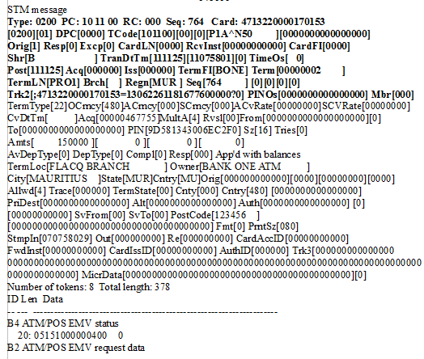
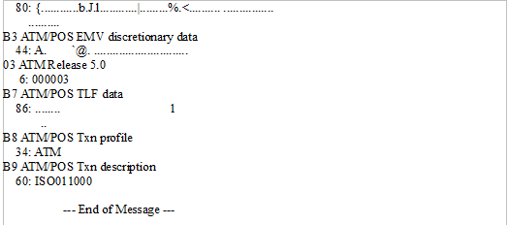

Slide 21
EXTERNAL MESSAGE:
When transaction messages are to be transfered from the Host interface to the Host or from the Host to the Host Interface then the External message are used. External messages are of two types:
ISO and ANSI.
The ISO message format contains mostly the message header, message type identifier, primary bit map and data elements.

Slide 22
The Message Header contains the fields like the product id, release number, message status, originator code and respondercode. The Message identifier is the type of the message send such as the transaction request (0200), transaction response (0210), etc. The data elements are the message bits which can be mandatory, conditional or avoided. The data elements are some specific data which is signified by the bit number and for seperate message the bits enabled will be different according to the requirement.

Slide 23
The data elements are 128 in number and they are divided into primary (1-64) and secondary (65-128).
Some of the data elements are:
P-1 Secondary Bit Map
P-3 Processing Code
P-4 Transaction Amount
P-7 Transmission Date and Time
P-11 Systems Trace Audit Number
P-12 Local Transaction Time
P-13 Local Transaction Date
P-15 Settlement Date
P-17 Capture Date
P-22 Point of Service Entry Mode
P-23 Card Sequence Number
P-32 Acquiring Institution Identification Code
P-35 Track 2 Data
P-37 Retrieval Reference Number
S-90 Original Data Elements
S-95 Replacement Amounts
S-100 Receiving Institution Identification Code
S-102 Account Identification 1
S-103 Account Identification 2
S-122 Card Issuer Identification Code
S-123 Deposit Credit Amount

Slide 24
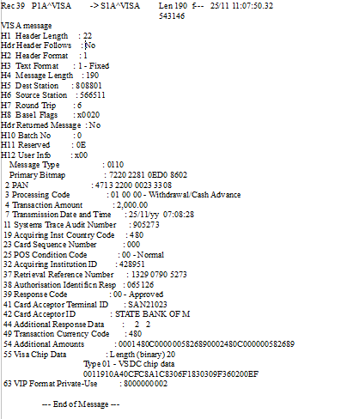
For Example:

Slide 25
THANK YOU....

